Slide 1
LECTURE-13 RISK MANAGEMENT
“Tomorrow problems are today's risk." Hence, a clear definition of a "risk" is a problem that could cause some loss or threaten the progress of the project, but which has not happened yet.
These potential issues might harm cost, schedule or technical success of the project and the quality of our software device, or project team morale. Risk Management is the system of identifying addressing and eliminating these problems before they can damage the project.
We need to differentiate risks, as potential issues, from the current problems of the project. Different methods are required to address these two kinds of issues.
For example, staff storage, because we have not been able to select people with the right technical skills is a current problem, but the threat of our technical persons being hired away by the competition is a risk.

Slide 2
Risk management
A software project can be concerned with a large variety of risks. In order to be adept to systematically identify the significant risks which might affect a software project, it is essential to classify risks into different classes. The project manager can then check which risks from each class are relevant to the project.
There are three main classifications of risks which can affect a software project:
Project risks
Technical risks
Business risks
1. Project risks: Project risks concern differ forms of budgetary, schedule, personnel, resource, and customer-related problems. A vital project risk is schedule slippage. since the software is intangible, it is very tough to monitor and control a software project. It is very tough to control something which cannot be identified. for any manufacturing program, such as the manufacturing of cars, the plan executive can recognize the product taking shape.
2. Technical risks: Technical risks concern potential method, implementation, interfacing, testing, and maintenance issue. It also consists of an ambiguous specification, incomplete specification, changing specification, technical uncertainty, and technical obsolescence. most technical risks appear due to the development team's insufficient knowledge about the project.
3. Business risks: This type of risks contain risks of building an excellent product that no one need, losing budgetary or personnel commitments, etc.

Slide 3
Other risk categories :
1. Known risks: Those risks that can be uncovered after careful assessment of the project program, the business and technical environment in which the plan is being developed, and more reliable data sources (e.g., unrealistic delivery date)
2. Predictable risks: Those risks that are hypothesized from previous project experience (e.g., past turnover)
3. Unpredictable risks: Those risks that can and do occur, but are extremely tough to identify in advance.
Principle of Risk Management
Global Perspective: In this, we review the bigger system description, design, and implementation. we look at the chance and the impact the risk is going to have.
Take a forward-looking view: Consider the threat which may appear in the future and create future plans for directing the next events.
Open Communication: This is to allow the free flow of communications between the client and the team members so that they have certainty about the risks.
Integrated management: In this method risk management is made an integral part of project management.
Continuous process: In this phase, the risks are tracked continuously throughout the risk management paradigm.

Slide 4
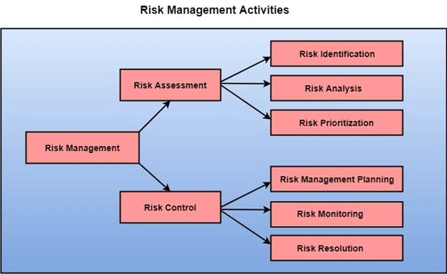
Risk Management Activities :
Risk Management consists of three main activities, as shown in fig:

Slide 5
RISK ASSESSMENT :
The objective of risk assessment is to division the risks in the condition of their loss, causing potential. for risk assessment, first, every risk should be rated in two methods:
The possibility of a risk coming true (denoted as r).
The consequence of the issues relates to that risk (denoted as s).
Based on these two methods, the priority of each risk can be estimated:
p = r * s
where p is the priority with which the risk must be controlled, r is the probability of the risk becoming true, and s is the severity of loss caused due to the risk becoming true. if all identified risks are set up, then the most likely and damaging risks can be controlled first, and more comprehensive risk abatement methods can be designed for these risks.
1. Risk Identification: The project organizer needs to anticipate the risk in the project as early as possible so that the impact of risk can be reduced by making effective risk management planning.
A project can be of use by a large variety of risk. to identify the significant risk, this might affect a project. it is necessary to categories into the different risk of classes.

Slide 7
RISK CONTROL
It is the process of managing risks to achieve desired outcomes. after all, the identified risks of a plan are determined; the project must be made to include the most harmful and the most likely risks. different risks need different containment methods. in fact, most risks need ingenuity on the part of the project manager in tackling the risk.
There are three main methods to plan for risk management:
Avoid the risk: this may take several ways such as discussing with the client to change the requirements to decrease the scope of the work, giving incentives to the engineers to avoid the risk of human resources turnover, etc.
Transfer the risk: this method involves getting the risky element developed by a third party, buying insurance cover, etc.
Risk reduction: this means planning method to include the loss due to risk. for instance, if there is a risk that some key personnel might leave, new recruitment can be planned.
Risk leverage: to choose between the various methods of handling risk, the project plan must consider the amount of controlling the risk and the corresponding reduction of risk. for this, the risk leverage of the various risks can be estimated.
Risk leverage is the variation in risk exposure divided by the amount of reducing the risk.
Risk leverage = (Risk exposure before reduction - Risk exposure after reduction) / (Cost of Reduction)

Slide 8
1. Risk planning: The risk planning method considers each of the key risks that have been identified and develop ways to maintain these risks. For each of the risks, you have to think of the behavior that you may take to minimize the disruption to the plan if the issue identified in the risk occurs. You also should think about data that you might need to collect while monitoring the plan so that issues can be anticipated.
Again, there is no easy process that can be followed for contingency planning. it rely on the judgment and experience of the project manager.
2. Risk monitoring: Risk Monitoring is the method king that your assumption about the product, process, and business risks has not changed.

Slide 9
QUESTIONS :
1. Risk management is one of the most important jobs for a
a) Client
b) Investor
c) Production team
d) Project manager
2. Which of the following risk is the failure of a purchased component to perform as expected?
a) Product risk
b) Project risk
c) Business risk
d) Programming risk
3. What assess the risk and your plans for risk mitigation and revise these when you learn more about the risk?
a) Risk monitoring
b) Risk planning
c) Risk analysis
d) Risk identification

Slide 10
QUESTIONS :
4. Which of the following risks are derived from the organizational environment where the software is being developed?
a) People risks
b) Technology risks
c) Estimation risks
d) Organizational risks
5. Risk management is now recognized as one of the most important project management tasks.
a) True
b) False

